Slide 1
Cleft Lip/ Palate
Starring Eamon

Slide 4
Labor Day 2006
September 4, 2006, Eamon Lane Franks-Cassidy was born.
He weighed 5lbs 7oz and was born 3 1/2 weeks early.

Slide 5
We brought him home 09/06/2006

Slide 6
Sent to Children’s Hospital 09/08/2008

Slide 7
Had a feeding obturator made while @ Children’s by Dr. Meredith Harris

Slide 8
Specialized Bottle
Haberman/ Special Needs Bottle

Slide 9
1st Surgery: Lip Repair @ 3 months
Day of surgery, waiting to go back to the operating room. Happy Baby!

Slide 10
After Lip Surgery in the Hospital
VERY MAD BABY! (Left)Just out of surgery (Right) An hour after surgery

Slide 11
At home after lip surgery
This was all he could smile for a week. His poor face was so swollen!

Slide 12
Life In-Between

Slide 13
2nd Surgery: Palate Repair

Slide 14
2nd Palate Surgery Extra Day
Our boy decided not to eat, so they wouldn’t let us out of the hospital!
Notes:
He wouldn’t eat for a week. We were STILL writing down every ounce that he drank and ate. He almost ended up in the hospital again because he wouldn’t eat. The second week was a little better and the third week was a lot better.

Slide 15
Life In-Between
Eamon’s 4th Birthday

Slide 16
Nasoendoscopy
Long, skinny tube with a camera at the end that goes UP THE NOSE!

Slide 17
3rd Surgery: Tonsillectomy & Adenoidectomy

Slide 18
3rd Surgery Recovery
He complained of pain for 14 days.

Slide 19
4th Surgery Furlow & Sphicteroplasty

Slide 20
Before Surgery Visits

Slide 21
More Visits

Slide 22
Time to get Mom & Dad Prepped

Slide 23
Recovery Room After Surgery

Slide 24
Private Room

Slide 25
Lots and LOTS of popsicles!
We had to melt popsicles for him to eat. We also had to blend all his food for 3 weeks. NO SOLIDS for THREE WEEKS!

Slide 26
Day One After Surgery

Slide 27
Cleft Palate Team
Plastic Surgeon, Ears, Nose & Throat Surgeon, Oral Maxillary Surgeon, Orthodontist, Dentist, Geneticist, Social Worker, Speech –Language Pathologist, Audiologist, Pediatrician

Slide 28
Until the Next Surgery…

Slide 29
Giving to Others in Need

Slide 30
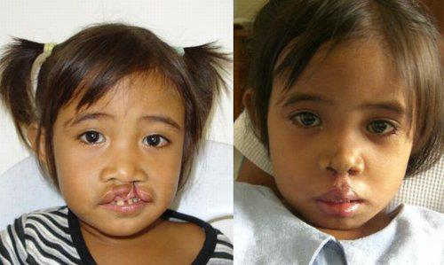
Other Countries

Slide 31
Famous Person w/ Cleft Palate
Guess Who?

Slide 32
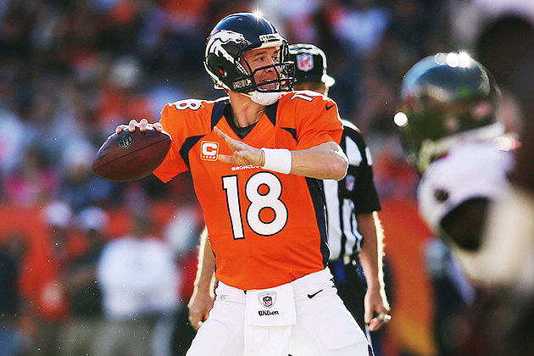
Peyton Manning!

