Slide 1


Strengthening Emotional Resilience
For Colorado Cleft Conference
May 3, 2014

Slide 2


Slide 3
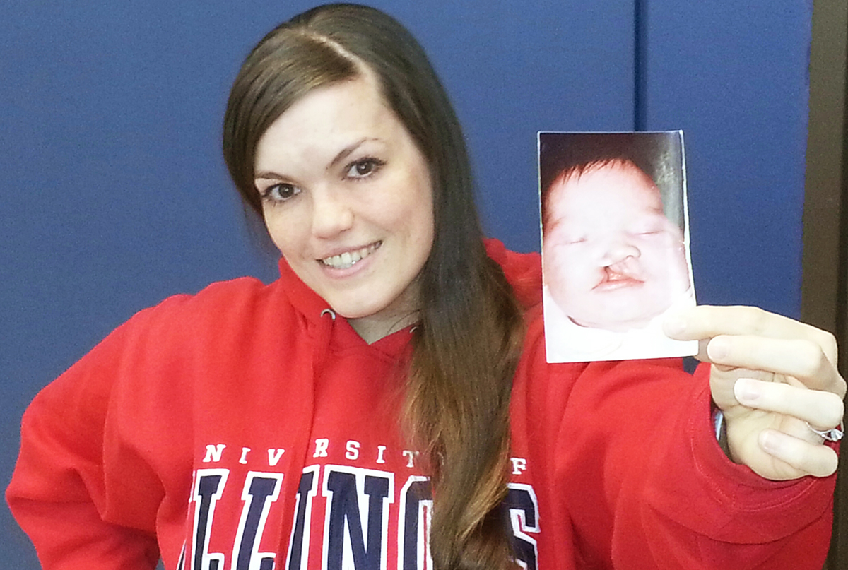
Your Cleft Strong
Adopted
Unexpected
Notes:
Insert Photo

Slide 4

Change vs. Transition
Change is the shift, transition is the process
of one state of being to another
CHANGE
TRANSITION
External
Organizational
Quicker
More visible
More predictable
Physical
Tangible
Internal
Personal
Slower
Less visible
Less predictable
Psychological
Intangible
By Catherine Adenle http://catherinescareercorner.com
Notes:
Difference between change and transition:
Change is situational and external
new house, loss of partner, new boss, new role, new system, new procedure, new legislation
Transition is psychological and internal
letting go, endings, neutral zone, new beginnings
How we think about a change is key
You can see change – its external. It is executed by a department, unit or organisation. Change is quicker because by the time it has reached the individual – the management has moved on. Change is visible. Change is more predictable – the end result is known. Change can be touched and felt.
Transition is internal – it is personal feelings/psychological. No 2 people will process it the same way and at the same speed. This is slower as people need time to process the information. Transition is less visible as it is internal – asking personal questions. Less predictable – there will be doubts and concerns. Transition is psychological – ‘how will it affect me?’ It is intangible.
(This is where you should seek support from the manager, HR or CAB)
In this slide, we talk about change vs transition
The actual change event itself is usually situational and external, such as a new house or a new boss
How we deal with that and make the transition is internal and psychological. How we deal with this internally can make a huge difference on our outlook on life. This is the basis of Cognitive Behavioural Therapy (CBT), an approach for dealing with depression, anxiety, etc.
In our view, helping to remove people’s fear, which is often irrational, has played a big positive part in managing change in the past.
A successful part of this was helping people to believe that their current skills will be attractive to other departments and companies, thus reducing the fear of redundancy.
Activity: Split into groups (complete exercise before next slide)
Think about examples of change in everyday life; thoughts & reactions
Think about changes in a work context; thoughts & reactions
Discussion – what are the differences & similarities?
Think about what you focus your energies on – influence and non influence.

Slide 5

STRESS = Is a Normal Physiological
Reaction to a Perceived Threat.
Definitions of Stress
Eustress vs. Distress

Slide 6

Resilience
To be resilient means to be able to 'spring back' into shape after being deformed. To be emotionally resilient means to be able to spring back emotionally after suffering through difficult and stressful times in one's life.
Stressed people experience a flood of powerful negative emotions which may include anger, anxiety, and depression. Some people remain trapped in these negative emotions long after the stressful events that have caused them have passed.
Emotionally resilient people, on the other hand, are quickly able to bounce back to their normal emotional state.

Slide 7

Traits of Emotional Resilience
Emotional Awareness
Perseverance
Internal Locus of Control
Optimism
Support
Sense of Humor
Perspective
Sense of Mission

Slide 8


What Would You Do If You Won?
Notes:
Turn to your partner and talk about what you would do…

Slide 9

Emotional Awareness
Be aware what your feeling, when you’re feeling…
Know why you’re feeling
Know the impact of your feeling on behavior, thoughts, performance
Mindfulness in the moment

Slide 10

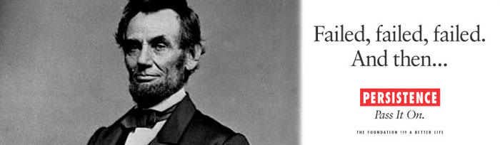
Perseverance
Notes:
Can you think of a time when you persevered?
What were the skills and beliefs that you used?
Ed Stafford – 34 years old
The first man to walk the Amazon River…to raise awareness about the environmental issues that are impacting the world’s river
He started on April 2, 2008 and finished on August 9, 2010…he walked for 859 days
Endured dodging venomous vapors, electric eels, scorpions, hundreds of wasp stings and an estimated 50,000 mosquito bites. He was imprisoned, wrongly accused of murder twice, and chased by locals with bows and arrows…and yet, he was
Action oriented
Trusted the process
Never gave up on his goal

Slide 11
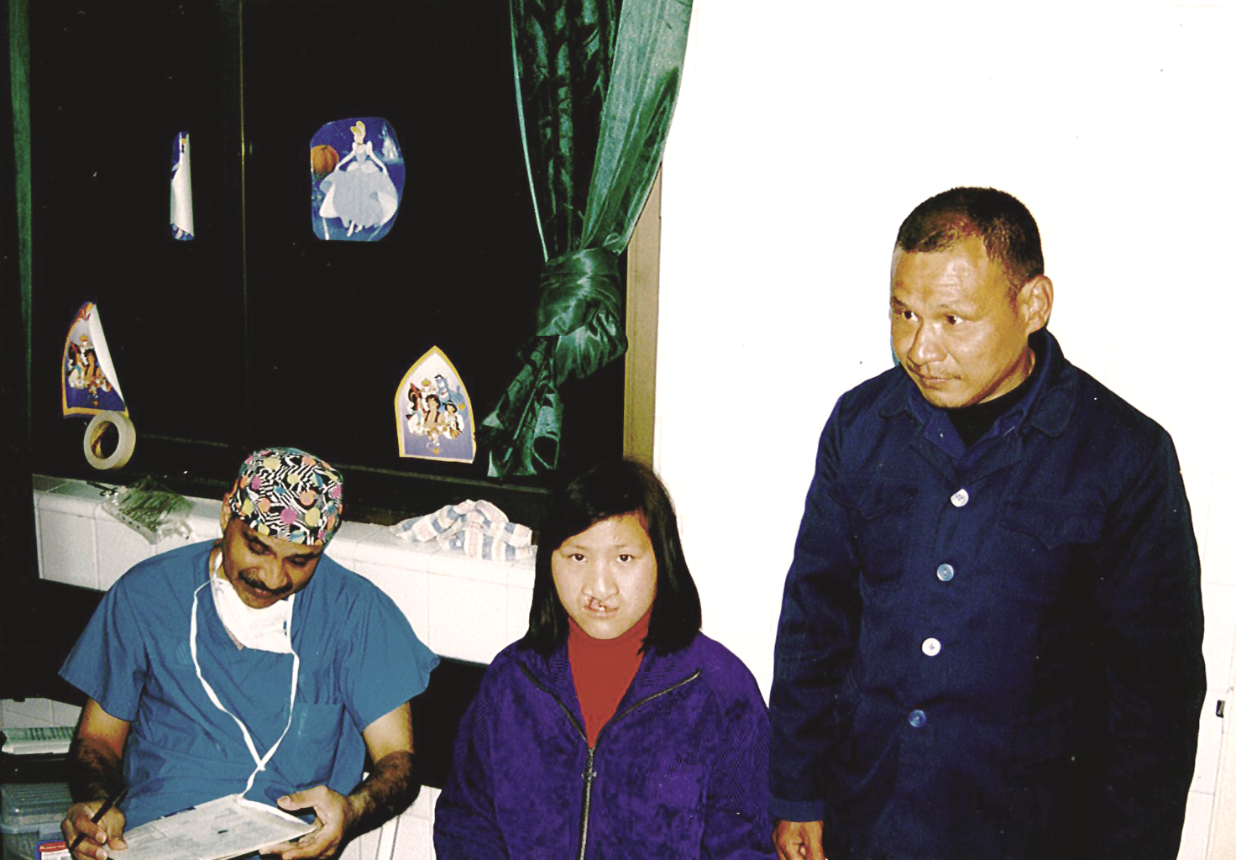

Slide 12

Internal Locus Of Control
Notes:
People who believe that they, rather than outside forces, are in control of their own lives internally.
Victor Frankle, “Man’s Search for Meaning” wrote
Is there someone that believes in you and has confidence in you…even if you’re not there yet? Can you borrow some of their confidence until you own it?
Permanence
Events are temporary versus permanent
Time is based on always or never
Pervasiveness
Specific versus universal
Events lead to everything or specifics
Personalization
Internal versus external
Blame ourselves or circumstances

Slide 13

Humor
Notes:
Reciprocal Inhibition – it means that two opposite emotions cannot occupy the same space in your brain at the same time. If you’re healthy, you can’t feel hatred and happy at the same time. When you impose a positive emotion over a negative one, one must fall out…and it’s usually the negative
Just thinking about positive experiences turns on the positive centers in our brain and reduces areas that sense pain.
What can you do to actively bring humor into your life?
People who are resilient have the ability to laugh at themselves and find a humorous element in most situations.
You Tube: Where the hell is Matt
The lion reunion
The mob dance at the Belgium train station to Julie Andrew’s “Favorite Things”

Slide 14
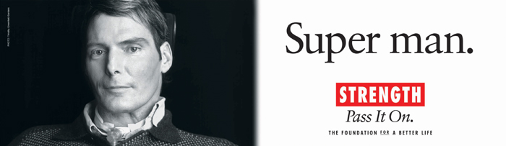
Perspective
Notes:
See obstacles as challenges
Allow adversity to make them stronger
Find meaning in life’s challenges rather than seeing themselves as a victim
Practice empathy and compassion

Slide 15
Perspective – Perseverance
Resilient people are able to
learn from their mistakes
(rather than deny them),
see obstacles as challenges,
and allow adversity to make
them stronger. They can also
find meaning in life’s challenges
rather than seeing themselves
as victims.
Regardless of setbacks and defeats we
trust in our resilience and don’t give up.

Slide 16
Optimism
Notes:
EXERCISE: Write your name with your least dominant hand
Optimism is a learned skill and it can be developed with practice
Optimists are ale to develop healthy thinking patterns – they see the positives is most situations and believe in their own strengths
Pony story

Slide 17
3 P’s of Explanatory Style
Permanence
  Events are temporary versus permanent
  Time is based on always or never
Pervasiveness
  Specific versus universal
  Events lead to everything or specifics
Personalization
  Internal versus external
  Blame ourselves or circumstances

Slide 18

Rational Problem Solving
Knowing your ABCs
and other positive mental handrails.
    Activating Event
    Belief or Expectation
    Consequence or Emotional Response
    Dispute
    Effect

Slide 19
Breathing and Centering

Slide 20

Support
Notes:
Who is in your support network? Where do you get support? Where do you give support? Do you need to give more of it? Do you need to ask for more of it?
Is there an opportunity to expand it?
Are there some individuals or environments where it’s time to let go and make some changes because they aren’t that supportive?

Slide 21

Sense of Mission

Slide 22

What is Your Commitment?
Notes:
His vision lead others and allowed people to see beyond imposed physical limitations
At 34, Eric became one of less than 100 people individuals to climb all of the 7 highest summits on all 7 continents

Slide 23

Patrick Hiester, BizPsych
www.BizPsych.com

