Slide 1
Collaborating with Your Local Teams
Recommendations from Your Clinical Coordinators
Jamie Idelberg, BS, RDH
Children’s Hospital Colorado
Theresa Snelling, M.A., CCC-SLP
Rose Medical Center

Slide 2
Team verb = come together as a team to achieve a common goal.
Team noun = Two or more people working together.

Slide 3
Team Concept
Teams are comprised of experienced and qualified professionals from medical, surgical, dental, and allied health disciplines working in an interdisciplinary and coordinated system.
The purpose and goal of Teams is to ensure that care is provided in a coordinated and consistent manner with the proper sequencing of evaluations and treatments within the framework of the patient’s overall developmental, medical, and psychological needs.

Slide 4
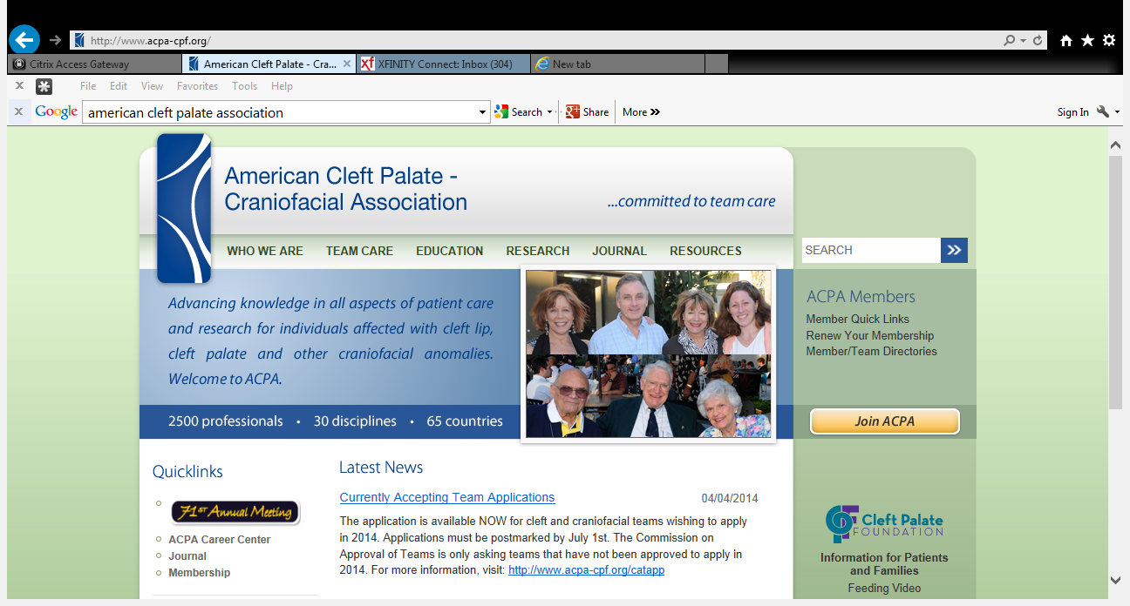


ACPA-CPF….amazing resource

Slide 6
American Cleft Palate Association
Multidisciplinary organization of over 2500 members.
Representing more than 30 disciplines in 60 countries.
Members of ACPA serve an extremely important role in the management of children and adults with cleft lip, cleft palate, and craniofacial anomalies
A primary objective of the Association is to foster communication and cooperation among professionals from all specialties.
Annual Education Meeting.

Slide 7



Slide 8
Team Composition
MUST HAVE to be a TEAM
Team Coordinator
Speech Pathologist
Surgeon
Orthodontist
Have access to:
Occupational Therapist
Social Worker
Psychologist
Genetic Counselor
Pediatrician
Audiologist
Pediatric Dentist
ENT Surgeon
Plastic Surgeon
Oral Surgeon
Nursing

Slide 9
How to Prepare for a Team Visit
Gather any important medical info
IEP reports
Speech reports
Hearing tests
Occupational Therapy reports
Dental x-rays
Any other reports from Community Providers
Bring them to the Clinic or send them in early

Slide 10

How to Prepare for a Team Visit
Inform your providers/therapists of CPC appointment date
Have appropriate release/consent forms signed
Invite therapist to attend Clinic
Make sure schools are in the loop….
Prepare your child

Slide 11
Issues Teams are Keen on….
Airway issues/sleep problems
Ear issues
Dental concerns/cavities
Psycho/social
Need/timing for additional surgeries:
  Surgeries for speech
  Bone grafts
  Lip revisions
  Others as needed

Slide 12
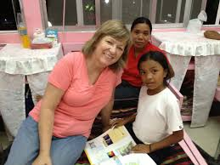
Speech Therapy….helpful hints
Let your speech therapist know if:
your child is congested

Slide 13
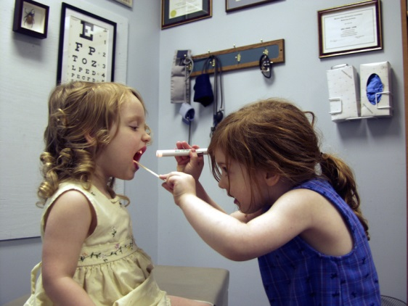
Thoughts:
Partner with your providers
Read & save your Clinic reports
Organize your medical records
Have your questions ready
Be proactive
Develop family traditions around Clinic visits/surgery
Teams take care of the “whole” child…

Slide 14

Team Care is the Standard of Care for children with cleft lip/palate and related conditions.
Cleft Palate Foundation
www.acpa-cpf.org

Slide 15

“Wonder”
I won't describe what I look like. Whatever you're thinking, it's probably worse.
August (Auggie) Pullman was born with a facial deformity that prevented him from going to a mainstream school—until now. He's about to start 5th grade at Beecher Prep, and if you've ever been the new kid then you know how hard that can be. The thing is Auggie's just an ordinary kid, with an extraordinary face. But can he convince his new classmates that he's just like them, despite appearances?
R. J. Palacio has written a spare, warm, uplifting story that will have readers laughing one minute and wiping away tears the next. With wonderfully realistic family interactions (flawed, but loving), lively school scenes, and short chapters, Wonder is accessible to readers of all levels.

Slide 16
